Slide 1


Python Webapp Programming
Questionnaire app with Django
--User login/logout

Slide 2
What does it mean: user account
A sign up form. Sign up process.
Login/logout.
After login, all activity assume the user_name same as this user.
If not login, then only able to do things not request be a valid user.
For those that need login (as a valid user), will present with login page then back.
When have any charges /accounting related to this user, must login to view / modify / make payment etc.

Slide 3
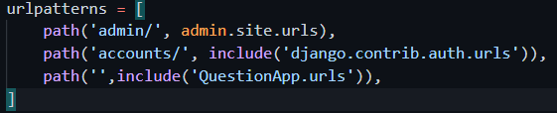
Django ready made login and logout
Django “auth” app, has the login and logout. It require a “registration” folder, for it’s template files.
Add ‘accounts/’ url for QuestionPrj/urls.py
Add a login template. (no need logout template as no need fill anything for logout)
PS> cd %Project_Root_Folder%
PS> pipenv shell
PS> makdir templates/registration
PS> ni templates/registration/login.html

Slide 4
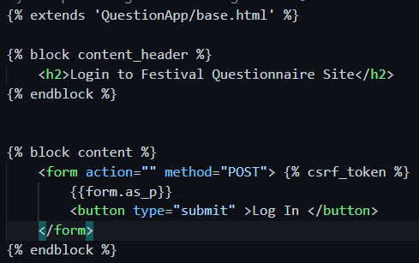
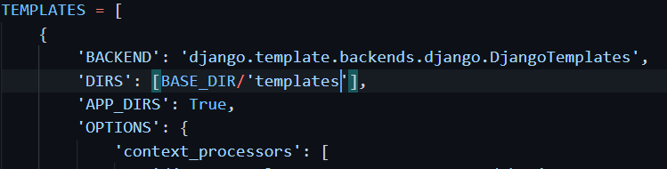
Django ready made login and logout
Login template file,
And login template location in settings.py

Slide 5
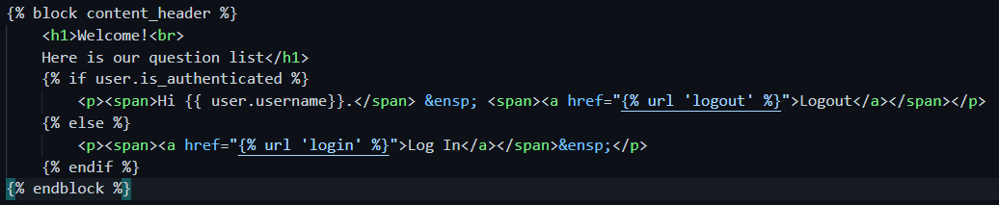
Django ready made login and logout
Add link in home.html

Slide 6

Django ready made login and logout
Still one step to go: after successful login, which page to land the user?
After successful logout, which page to land the user?
We give this in settings.py

Slide 7
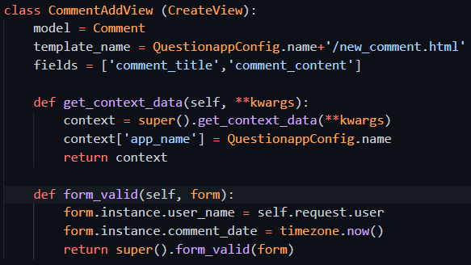
After login, how to use the user information when post comment
For the add_comment view, remove the field of name and datetime, and we use form_valid to add the value from login user, and system time.

Slide 8
Add authorization: if not login, not allow add/delete/update, only allow view
For the add/delete/update view, add multiple inheritance, put LoginRequiredMixin before the corresponding view
If not login but try to edit/add/delete, will get a result of 404
This is because the URL contains additional parameters, and the Django default url conf of auth app cannot handle it.
Now Django auth already can handle this, so use built-in login process this can be done, no need customize.

Slide 9
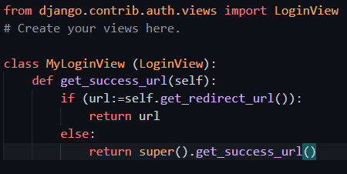
Add a view for the new user app
New LoginView class
Now Django auth already can handle this, so use built-in login process this can be done, no need customize.

Slide 10

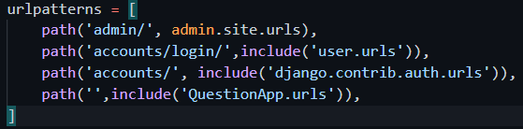
Add a new user app, then create new view to handle login
New app user
Add urls.py for the new app
In site urls include this app urls
PS> py manage.py createapp user
PS> cd user
PS> ni urls.py
Now Django auth already can handle this, so use built-in login process this can be done, no need customize.

Slide 11
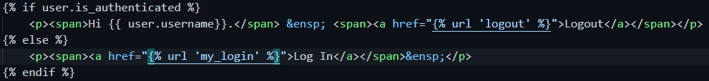
Change home link to use this new login
We use our created LoginView, but use Django default LogoutView, together works no problem.

Slide 12

New problem of authorization
After we login, even we are login with “user a”, but is allowed to edit or delete comment which produced by “user b”
Do in the edit and delete view, we need to check user, only same user then it is allowed.
We can do this check in the get() function, which deals all the get request process.

Slide 13
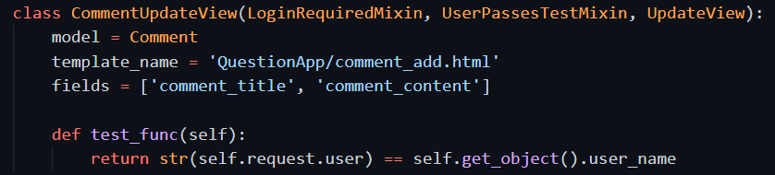
New problem of authorization
A better place to do this is to inherit UserPassesTestMixin.
Add it for both update view and delete view.
So now we have 2 mixin, they can work together perfectly.
Multi inheritance order from left to right is important, as it relates to MRO

Slide 14
Push to repo, deploy to Heroku cloud
PS> cd QuestionPrj
PS> git status
PS> git add –A
PS> git commit –m “add user account deploy”
PS> git push origin main
PS> git push heroku main
PS> heroku ps:scale web=1

